Slide 1

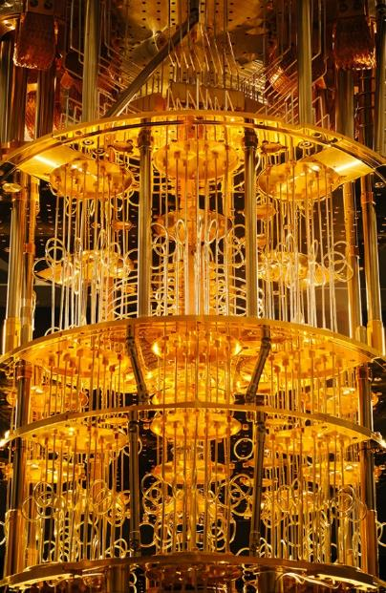
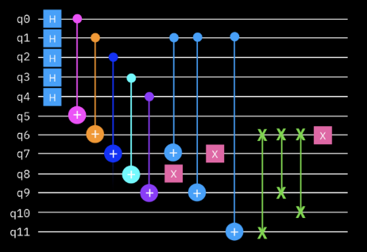



Foundations of
Quantum Information Science (QIS 101)
Dave Biersach
Brookhaven National Laboratory
dbiersach@bnl.gov
Session 24a
Quantum Algorithms

Slide 2
Session 24a – Goals
Review the Kronecker product of vectors and how to boost the tensor rank of a vector to be that of a matrix
How to manipulate a qubit's phase using quantum gates
Analyze the phenomenon of phase kickback between entangled qubits
Implement the Deutsch Oracle using Qiskit and mathematically trace the Deutsch algorithm
Implement the Deutsch-Jozsa Oracle using matrices
Understand how Grover's Algorithm leverages phase amplification to increase the probability that a wave function will collapse to a meaningful state

Slide 3
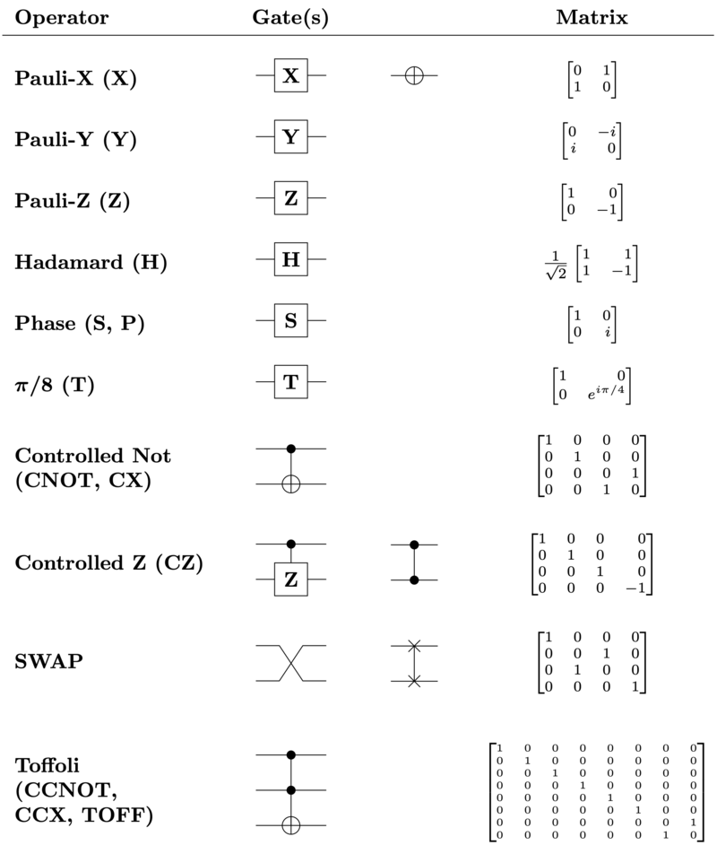

Slide 4
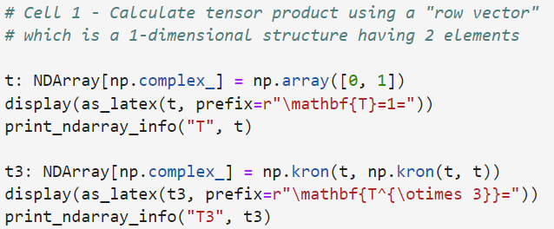
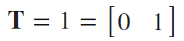
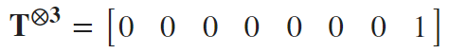
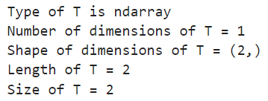
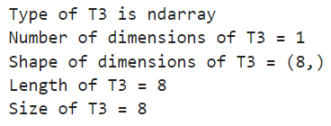
Run Cell 1 – phase_kickback.ipynb
①
②
③
④
⑤

Slide 5
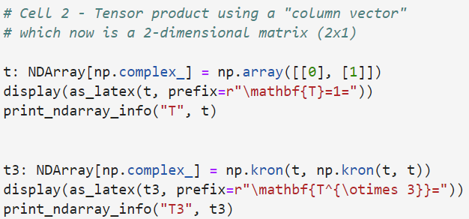
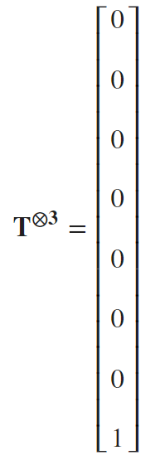
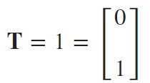
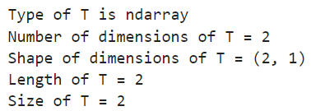
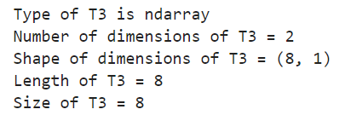
Run Cell 2 phase_kickback.ipynb
①
②
③
④
⑤

Slide 6
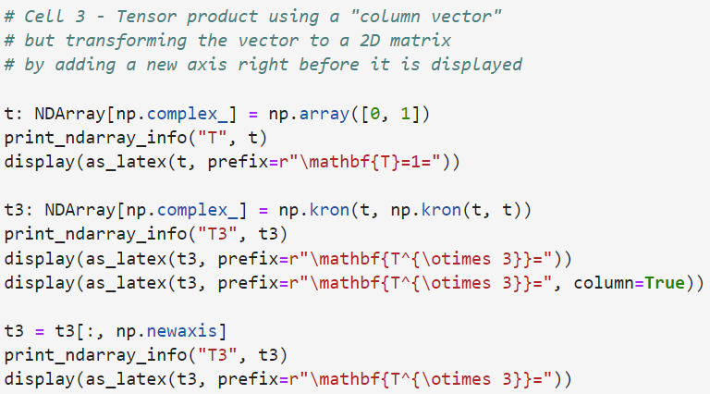
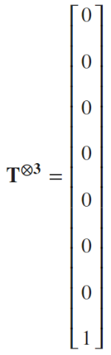
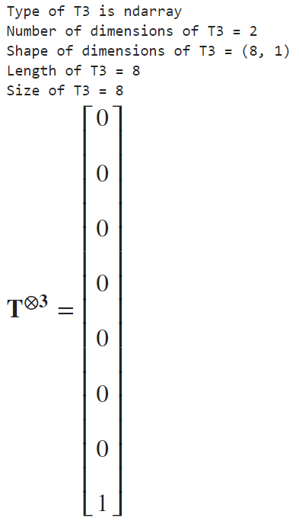
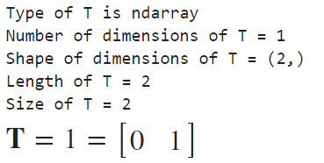
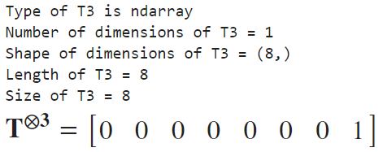
Run Cell 3 – phase_kickback.ipynb
①
②
③
⑤
These
"look"
similar
⑥
④

Slide 7
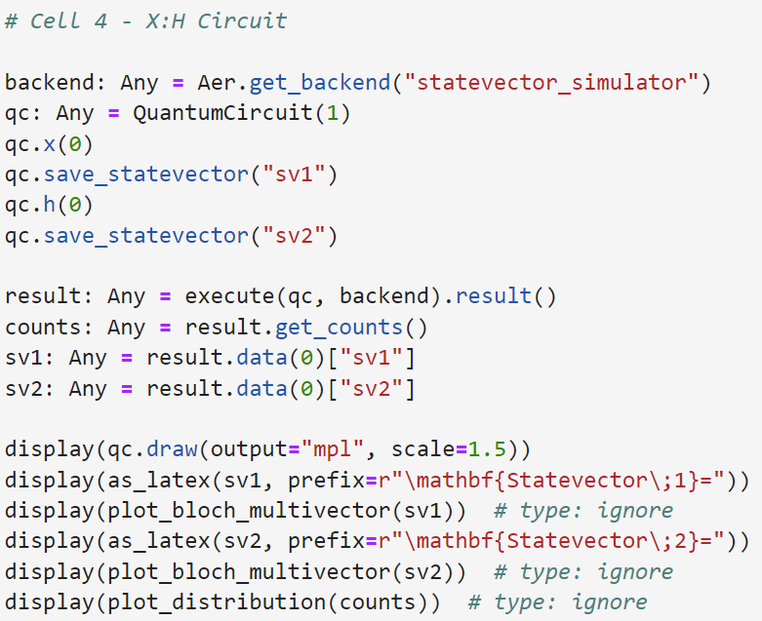
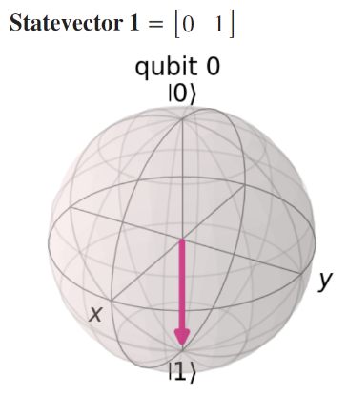
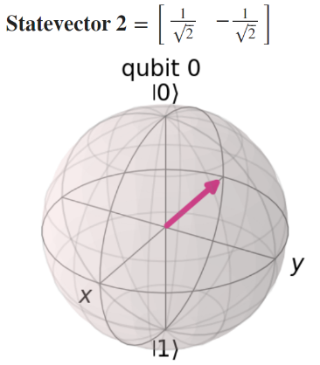
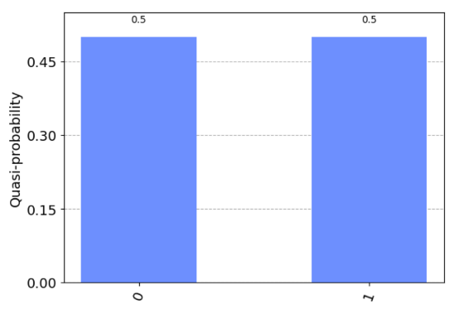
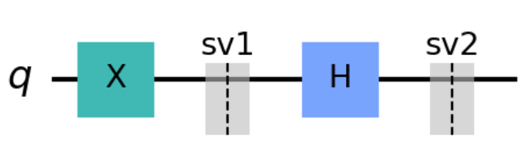
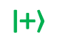
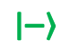
Run Cell 4 phase_kickback.ipynb
①
②
③
④
⑤
$$\left|\left.−\right\rangle \right.$$
⑥
$$\left|\left.+\right\rangle \right.$$

Slide 8
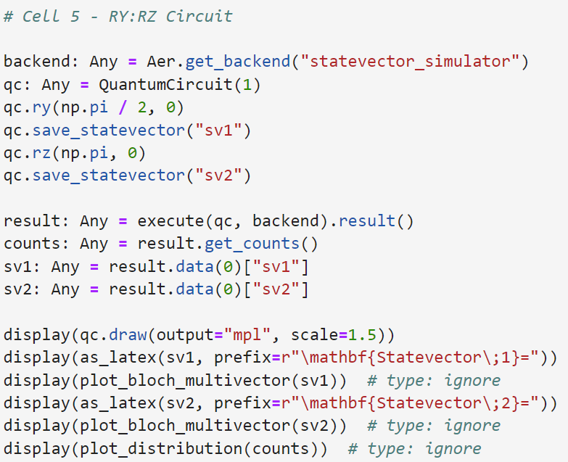
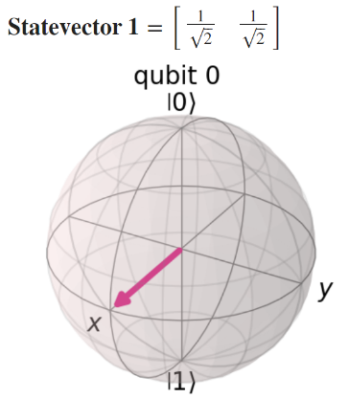
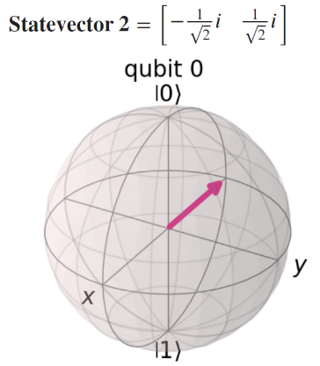
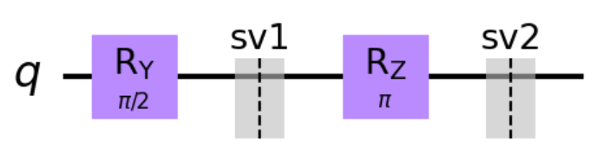
Run Cell 5 phase_kickback.ipynb
①
②
③
④
⑤
⑥

Slide 9
The Route Matters
The probabilities are the same, but the amplitudes are not!

Slide 10
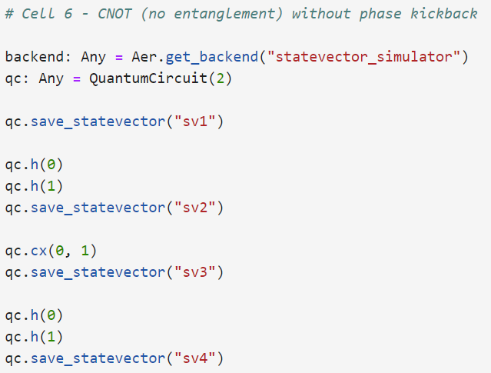
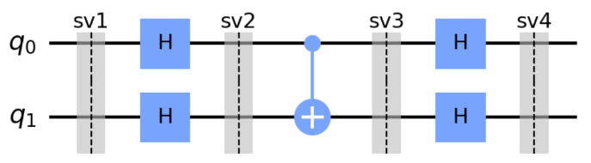
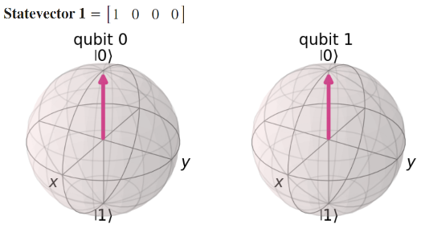
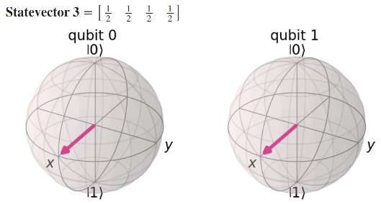
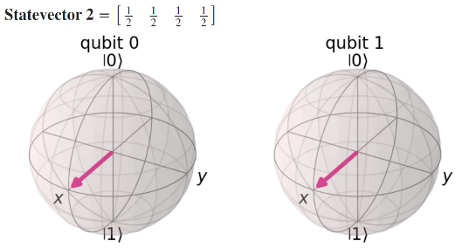
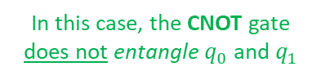
①
Run Cell 6 phase_kickback.ipynb
②
③
④
⑤
In this case, the CNOT gate
does not entangle $q_{0}$ and $q_{1}$
1
0

Slide 11

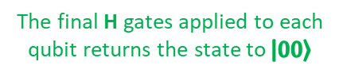
①
Run Cell 6 phase_kickback.ipynb
②
③
④
⑤
The final H gates applied to each qubit returns the state to $\left|\left.00\right\rangle \right.$

Slide 12
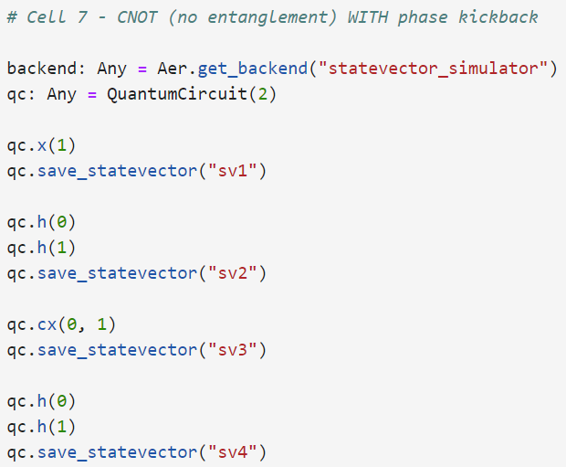
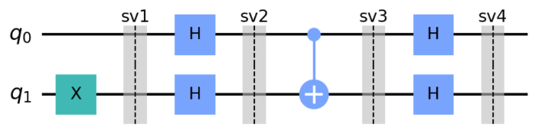
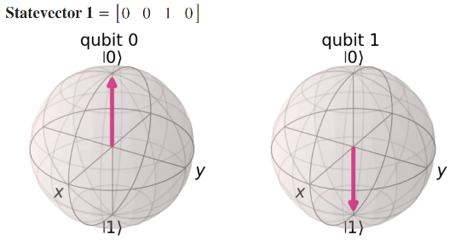
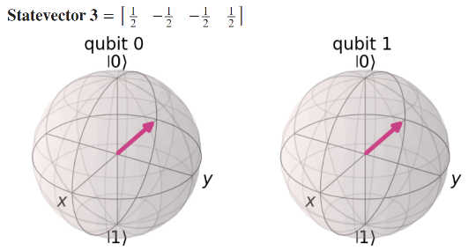
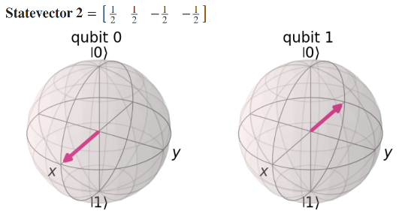
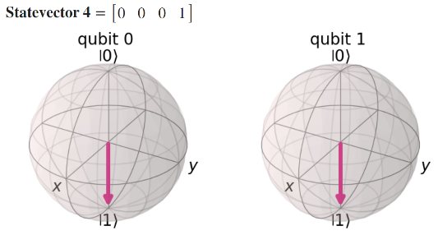
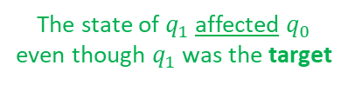
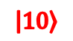
①
Run Cell 7 phase_kickback.ipynb
②
③
$$\left|\left.10\right\rangle \right.$$
④
⑤
The negative phase moved backwards
The state of $q_{1}$ affected $q_{0}$ even though $q_{1}$ was the target
⑥

Slide 13
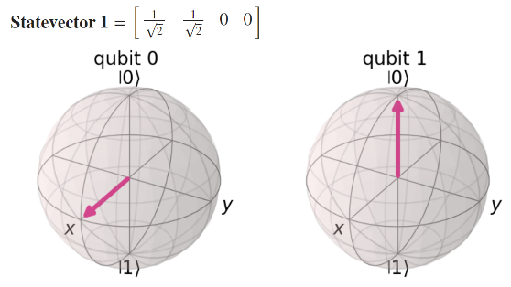
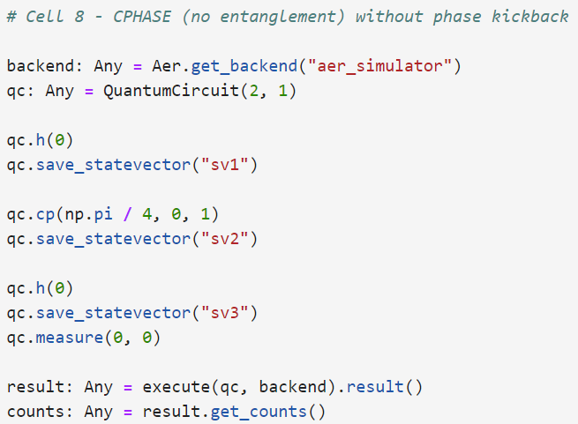

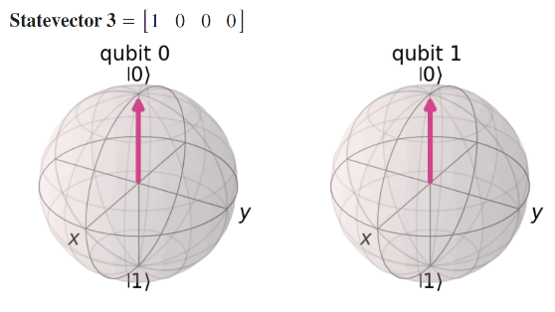
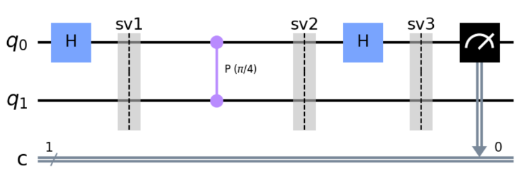
Run Cell 8 phase_kickback.ipynb
①
②
③
④
⑤

Slide 14
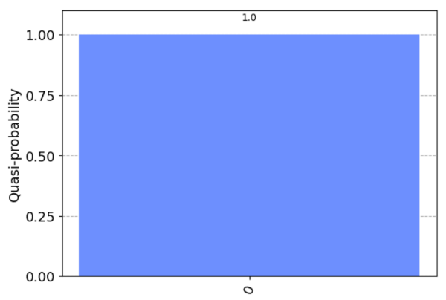
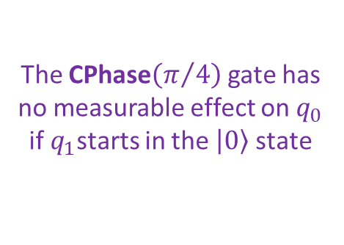
Run Cell 8 phase_kickback.ipynb
The CPhase$\left(π/4\right)$ gate has no measurable effect on $q_{0}$
if $q_{1}$starts in the $\left|\left.0\right\rangle \right.$ state
①
②
③
④
⑤
⑥

Slide 15





Run Cell 9 phase_kickback.ipynb
①
②
③
④
⑤

Slide 16


Run Cell 9 phase_kickback.ipynb
Because $q_{1}$started in the $\left|\left.1\right\rangle \right.$ state,
the CPhase$\left(π/4\right)$ gate has affected $q_{0}$ due to kickback
①
②
It no longer measures only 0 as on slide 14
③
④
⑤
⑥

Slide 17






Run Cell 10 phase_kickback.ipynb
①
Supposed we didn't know this phase $φ$
②
③
④
⑤

Slide 18


Run Cell 10 phase_kickback.ipynb
Because all measurements of $q_{0}$ are $\left|\left.0\right\rangle \right.$ we know the initial phase of $q_{0}$ was equal to the CPhase$\left(π/4\right)$ gate
①
②
③
④
⑤
⑥

Slide 19





Run Cell 11 phase_kickback.ipynb
①
②
③
④
⑤

Slide 20


Run Cell 11 phase_kickback.ipynb
Because we got at least one $\left|\left.1\right\rangle \right.$ measurement, we know the initial phase of $q_{0}$ was not equal to the CPhase$\left(π/4\right)$ gate
①
②
③
④
⑤
⑥

Slide 21




The Deutsch Algorithm
You are the traveler
You are the traveler, and you prepare two qubits $q_{0}$ and $q_{1}$ in whatever state you wish
You approach me, the Oracle, and present your two qubits
I apply one of four possible secret functions to your two qubits and return the two qubits to you
I am the wise Oracle
You are free to do what you want with the qubits afterward, but at some point, you must measure one (and only one) of the qubits $q_{0}$ or $q_{1}$
Based upon your single measurement, you must tell me which type of function I applied

Slide 22




The Deutsch Algorithm
You are the traveler
There are the four possible secret functions and only the Oracle knows which one is being used
Type of Function
NOP – I don't change your $q_{0}$qubit at all (no operation) e.g., $\left.\left|0\right.\right\rangle →\left.\left|0\right.\right\rangle ,\left.\left|1\right.\right\rangle →\left.\left|1\right.\right\rangle$
Balanced
Always 0 – I always set your qubit $q_{0}$ to the $\left.\left|0\right.\right\rangle$ state
Constant
I am the wise Oracle
Always 1 – I always set your qubit $q_{0}$ to the $\left.\left|1\right.\right\rangle$ state
Constant
NOT – I invert your $q_{0}$ qubit with an X gate e.g., $\left.\left|0\right.\right\rangle →\left.\left|1\right.\right\rangle ,\left.\left|1\right.\right\rangle →\left.\left|0\right.\right\rangle$
Balanced

Slide 23
The Deutsch Algorithm
You are the traveler
How many trips to the Oracle must you make
to know for sure if my secret function
is Balanced or Constant ?
Type of Function
NOP – I don't change your $q_{0}$qubit at all (no operation) e.g., $\left.\left|0\right.\right\rangle →\left.\left|0\right.\right\rangle ,\left.\left|1\right.\right\rangle →\left.\left|1\right.\right\rangle$
Balanced
Always 0 – I always set your qubit $q_{0}$ to the $\left.\left|0\right.\right\rangle$ state
Constant
I am the wise Oracle
Always 1 – I always set your qubit $q_{0}$ to the $\left.\left|1\right.\right\rangle$ state
Constant
NOT – I invert your $q_{0}$ qubit with an X gate e.g., $\left.\left|0\right.\right\rangle →\left.\left|1\right.\right\rangle ,\left.\left|1\right.\right\rangle →\left.\left|0\right.\right\rangle$
Balanced

Slide 24





Deutsch-Jozsa Algorithm

Slide 25
Quantum Supremacy
The Deutsch-Jozsa algorithm demonstrates (but does not prove) quantum supremacy because no classical computer can outperform this specific quantum circuit
Deutsch's 1985 paper described an Oracle with a single input, but in 1992, he (along with Richard Jozsa) expanded the algorithm to include any number of inputs
With four possible secret functions: no operation (NOP), constant 0, constant 1, and inverse (NOT), one might assume two trips to the Oracle would be required to prove which type of secret function was applied
But Deutsch changes the basis: the 1st question becomes "constant or balanced?" and the 2nd question would be "which version of constant or balanced" …but we don't have to ask that 2nd question!

Slide 26








The Deutsch Algorithm
The Oracle's secret function sits between sv2 and sv3
There are four possible secret functions - only the Oracle knows which one is being used
Type of Function
NOP – I don't change your $q_{0}$qubit at all (no operation) e.g., $\left.\left|0\right.\right\rangle →\left.\left|0\right.\right\rangle ,\left.\left|1\right.\right\rangle →\left.\left|1\right.\right\rangle$
Balanced
Always 0 – I always set your qubit $q_{0}$ to the $\left.\left|0\right.\right\rangle$ state
Constant
Always 1 – I always set your qubit $q_{0}$ to the $\left.\left|1\right.\right\rangle$ state
Constant
NOT – I invert your $q_{0}$ qubit with an X gate e.g., $\left.\left|0\right.\right\rangle →\left.\left|1\right.\right\rangle ,\left.\left|1\right.\right\rangle →\left.\left|0\right.\right\rangle$
Balanced

Slide 27




Run Cells 1 to 8 – deutsch.ipynb
There are four possible secret functions - only the Oracle knows which one is being used
Type of Function
Cell 1 – NOP : $q_{0}$ $\left.\left|0\right.\right\rangle →\left.\left|0\right.\right\rangle$
Cell 2 – NOP : $q_{0}$ $\left.\left|1\right.\right\rangle →\left.\left|1\right.\right\rangle$
Balanced
Cell 3 – Always 0 : $q_{0}$ $\left.\left|0\right.\right\rangle →\left.\left|0\right.\right\rangle$
Cell 4 – Always 0 : $q_{0}$ $\left.\left|1\right.\right\rangle →\left.\left|0\right.\right\rangle$
Constant
Cell 5 – Always 1 : $q_{0}$ $\left.\left|0\right.\right\rangle →\left.\left|1\right.\right\rangle$
Cell 6 – Always 1 : $q_{0}$ $\left.\left|1\right.\right\rangle →\left.\left|0\right.\right\rangle$
Constant
Cell 7 – NOT : $q_{0}$ $\left.\left|0\right.\right\rangle →\left.\left|1\right.\right\rangle$
Cell 8 – NOT : $q_{0}$ $\left.\left|1\right.\right\rangle →\left.\left|0\right.\right\rangle$
Balanced

Slide 28


The Deutsch Algorithm
You are the traveler
How many trips to the Oracle must you make
to know for sure if the secret function
is Balanced or Constant ?
You are the traveler, and you prepare two qubits $q_{0}$ and $q_{1}$ in whatever state you wish
You are free to do what you want with the qubits afterward, but at some point, you must measure one (and only one) of the qubits $q_{0}$ or $q_{1}$
I am the wise Oracle
The secret function we don't know

Slide 29



The Deutsch Algorithm
You are the traveler
How many trips to the Oracle must you make
to know for sure if the secret function
is Balanced or Constant ?
ONE !
Invert $q_{1}$ then put both qubits into a superposition, and then send them into the Oracle's secret function
After the secret function, take $q_{0}$ out of superposition and measure its value to determine if the Oracle was balanced or constant
I am the wise Oracle
The secret function we don't know

Slide 30






Run Cell 9 – deutsch.ipynb
①
②
00
10
③
NOP

Slide 31





Run Cell 10 – deutsch.ipynb
①
②
01
11
③
Always 0

Slide 32



Run Cell 11 – deutsch.ipynb
①
②
01
11
③
Always 1

Slide 33



Run Cell 12 – deutsch.ipynb
①
②
00
10
③
NOT

Slide 34



Deutsch's Algorithm – The Math
Think FOIL, regroup, then factor out
$\left|\left.0\right\rangle \right.$ and $\left|\left.1\right\rangle \right.$

Slide 35


Deutsch's Algorithm – The Math

Slide 36

Deutsch's Algorithm – The Math

Slide 37







The Deutsch-Jozsa Oracle
Inputs:
x is a two-qubit register (tensor)
y is an independent qubit
Consider the following
balanced function
The Secret Function
$$x$$
$$f(x)$$
$$x$$
$$y$$
$$x$$
$$y^{′}$$
We don't "know" this matrix as it is the nature (type) of $f\left(x\right)$ that we are trying to discover!
$$y^{′}=f(x)⊕y$$

Slide 38




A Quantum Algorithm as a Matrix
x
g1
y
I
g2
g3
t1
t2
g4
Assume n = 2 as our secret function maps two input bits to a single bit
Only a constant function will produce a $\left.|ψ\right\rangle$ of $\left[x,0,0,0,0,0,0,0\right]$

Slide 39



Open Cell 1 deutsch_jozsa.ipynb
①
②
③
⑥
⑦
⑧
⑨
⑩
Note: This notebook does not use any Qiskit features – only pure linear (matrix) algebra
④
⑤

Slide 40


Run Cells 1-4 deutsch_Jozsa.ipynb
①
②
③
④

Slide 41

The Deutsch-Jozsa Oracle
On a quantum computer, we can answer the question of whether the hidden function is balanced or constant in just one step – no matter the number of input qubits
This is exponential speed-up over the provably optimal classical algorithm which requires (on average) $2^{n−1}+1$ steps for a function with $n$ inputs
This is an admittedly contrived problem, but it shows the potential for a quantum computer to outperform classical algorithms that were thought to be "optimal"
It is also noteworthy that to learn the fundamentals of quantum computing, you only need to know a little Python and appreciate complex numbers and matrix algebra

Slide 42

The Deutsch-Jozsa Oracle
https://qiskit.org/textbook/ch-algorithms/deutsch-jozsa.html

Slide 43







Grover's Algorithm
Finding the Winner
Avg. Case = N / 2
Worst Case = N
N slots
if N = 3
(number of slots)
map to
This matrix puts the winner in slot 5
(zero-indexed)
$ω$ is the slot with the winner
= $5_{10}$

Slide 44

Grover's Algorithm
Ancilla qubit

Slide 45




Grover's Algorithm
Assume four slots (N = 2)
Initialization
$$U_{f}$$
$$\left|\left.s\right\rangle \right.$$
To find the winner among 4 slots we only need to run Grover's algorithm once
The Oracle decrees (encodes) which state is the winner
A CZ gate marks the winner to be in slot 3 aka [0,0,0,1]
The current mean amplitude

Slide 46

Grover's Algorithm
Initialization
$$U_{f}$$
$$\left|\left.s\right\rangle \right.$$
The Oracle decrees (encodes) which state is the winner
A CZ gate marks the winner to be in slot 3 aka [0,0,0,1]
The new mean amplitude

Slide 47

Grover's Algorithm
Initialization
$$U_{f}$$
$$\left|\left.s\right\rangle \right.$$
The Oracle decrees (encodes) which state is the winner
A CZ gate marks the winner to be in slot 3 aka [0,0,0,1]
We have amplified the amplitude of the winning state!
The new mean amplitude

Slide 48

Grover's Algorithm
Yes, we would need to know the location of the winning slot ahead of time to construct the Oracle's unitary matrix – so we cannot magically use Grover's algorithm on existing classical (non-quantum) databases

Slide 49



Run Cell 1 grover.ipynb
①

Slide 50




Run Cell 2 - grover.ipynb
①
②
③
The winner is in slot 3 [0,0,0,1]
⑤
④
⑥
⑦
⑧
⑨
⑩
sv1
sv2
sv3
sv4
sv5
sv6

Slide 51




①
Run Cells 3 & 4 grover.ipynb
②
③
sv1
sv2
④
⑤
⑥
sv1
sv2
⑦
⑧
⑩

Slide 52






①
Run Cells 5 & 6 grover.ipynb
②
sv1
sv2
③
sv1
sv2
④
⑤
⑥
⑦
⑧
$$\left|\left.00\right\rangle \right.$$

Slide 53

Session 24a – Now You Know
Vectors are 1-dimensional constructs, they have no transpose
To conform to the rules of standard matrix multiplication, or to use array display functions, we may have to boost a vector's dimensions to be a 2-D matrix
Numpy supports Python's array slicing syntax and can add a pseudo row/column using np.newaxis
The numpy.dot() operator gracefully handles the multiplication of scalars, vectors, and matrices
A qubit's phase onto itself does not affect its probability of a $\left|\left.0\right\rangle \right.$ or $\left|\left.1\right\rangle \right.$but will affect the outcome of a Hadamard gate

Slide 54
Session 24a – Now You Know
When the phase of a target qubit in a controlled gate affects the phase of the control qubit, it is called phase kickback
The Deutsch Oracle is a trivial algorithm but was one of the first to demonstrate (but not prove) quantum supremacy
If you cannot step-by-step explain a quantum algorithm using raw state vectors, brackets, tensors, unitary matrices, and matrix multiplication, then you don't understand the algorithm – it is not magic – it is linear algebra
The phase amplification used in Grover's Algorithm leverages increases the probability that a wave function will collapse to a meaningful state

